Slide 1
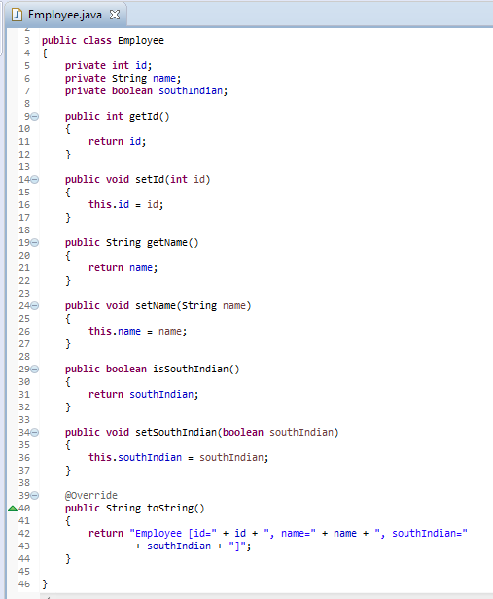
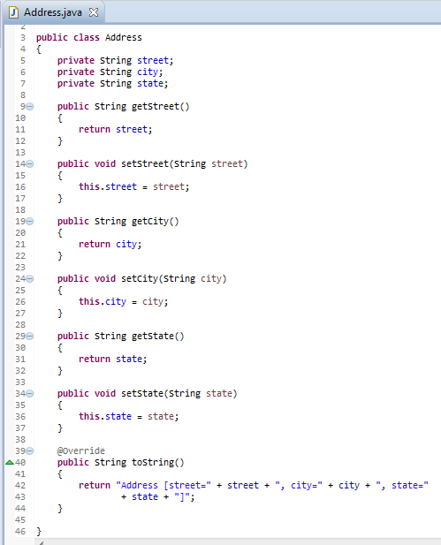
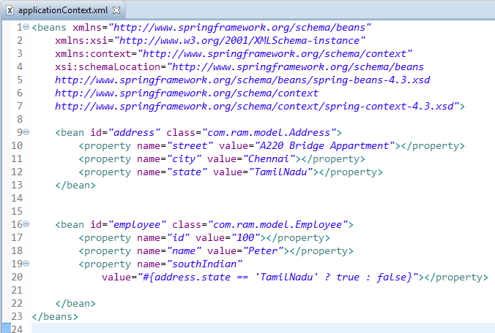
Spring EL ternary operator (if-then-else) example - XML
Spring EL supports ternary operator , perform “if then else” conditional checking. For example,
condition ? true : false

Slide 2
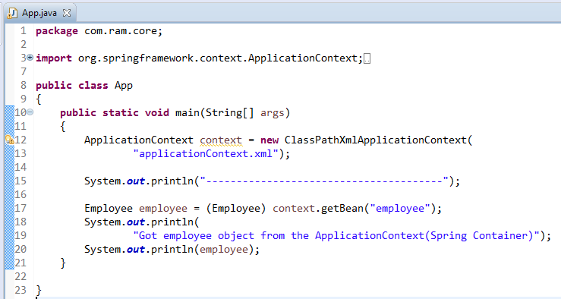
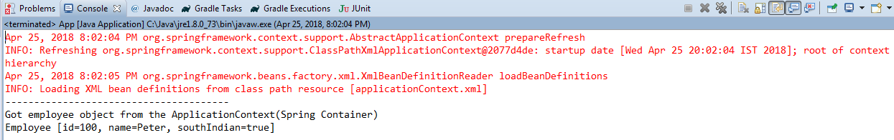
Spring EL ternary operator (if-then-else) example - XML

